Slide 1
The Politics of Global Economics

Slide 2
Kingdom
Politics
Global Economics

Slide 4
2 aspects of Christ’s teaching: personal and corporate
Personal = the beatitudes, Matt. 5: 3-9
… for they shall …
… for they shall …
… for they shall …
Except one: … for theirs IS – present tense
Blessed are the poor in spirit for theirs is the Kingdom of Heaven
Corporate = the Kingdom
The downside-up kingdom

Slide 5
Within that dual mandate, who are we to be?
“Love without courage and wisdom is sentimentality, as with the ordinary church member.
Courage without love and wisdom is foolhardiness, as with the ordinary soldier.
Wisdom without love and courage is cowardice as with the ordinary intellectual.
The one who has love, courage, and wisdom is one in a million, who moves the world, as with Jesus, Buddha, and Gandhi.”
Ammon Hennacy

Slide 7
Politics = the activities … especially the debate or conflict among individuals or parties having or hoping to achieve power.
3 primary drives: money, sex, and power – once we have some of all three, the only one without limits is power
So, at the highest levels, we need to dissect global economics through the lens of power, and not money (or sex)
Money is simply the forum or ground of getting and displaying power
On the truly global level, do not follow the money, but FOLLOW THE POWER

Slide 8
Here is 1 example of many:
The power of populism
2017 Cambridge Dictionary Word of the Year = Populism

Slide 9
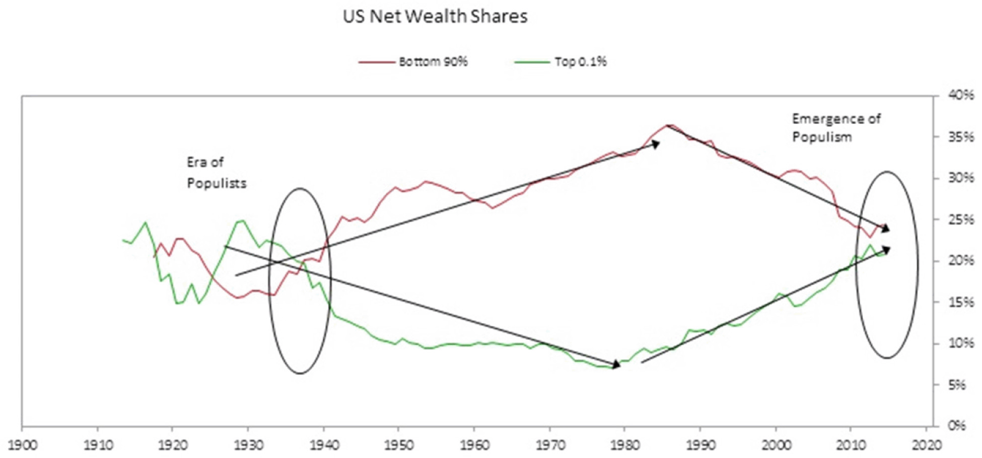
Source: Ray Dalio

Slide 10
What is the Kingdom response?

Slide 11
Global Economics

Slide 12
Our 4 greatest challenges
Debt
Jobs
Demographics
Thucydides’ Trap

Slide 13
Debt
The government follows its own accounting rules
And these are:
Under standard rules, it would owe the “fiscal gap”
Which is about $210T
And what is that????

Slide 14
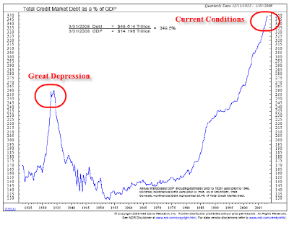

Slide 15
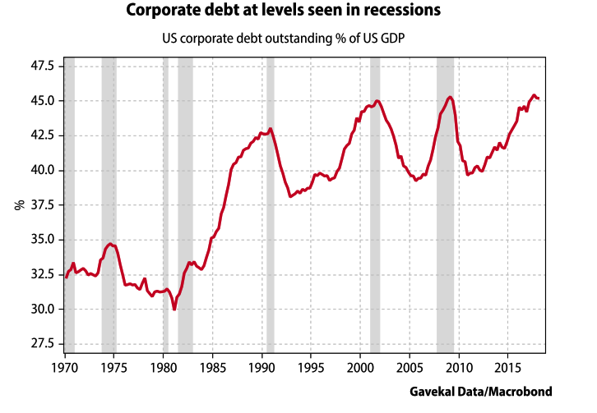

Slide 16
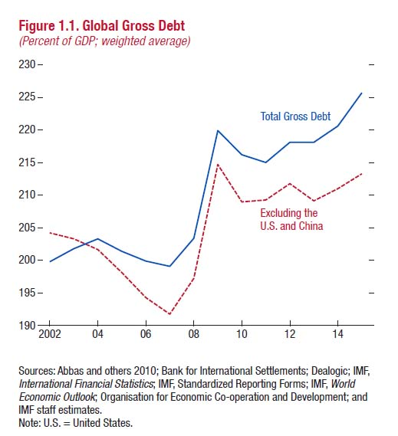

Slide 17
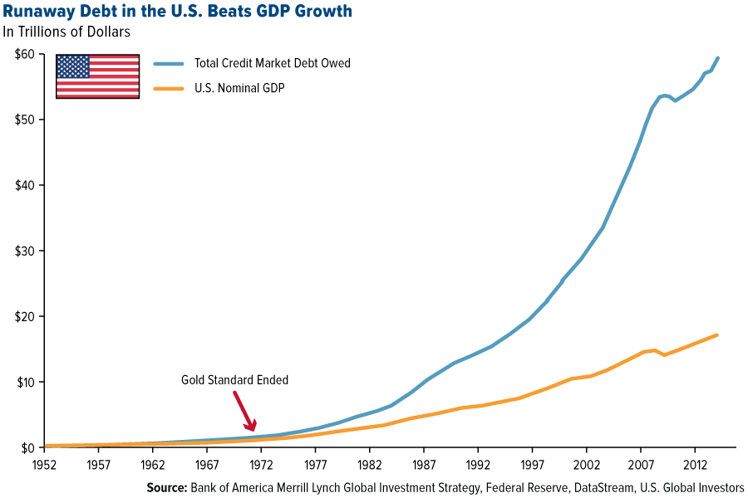

Slide 18
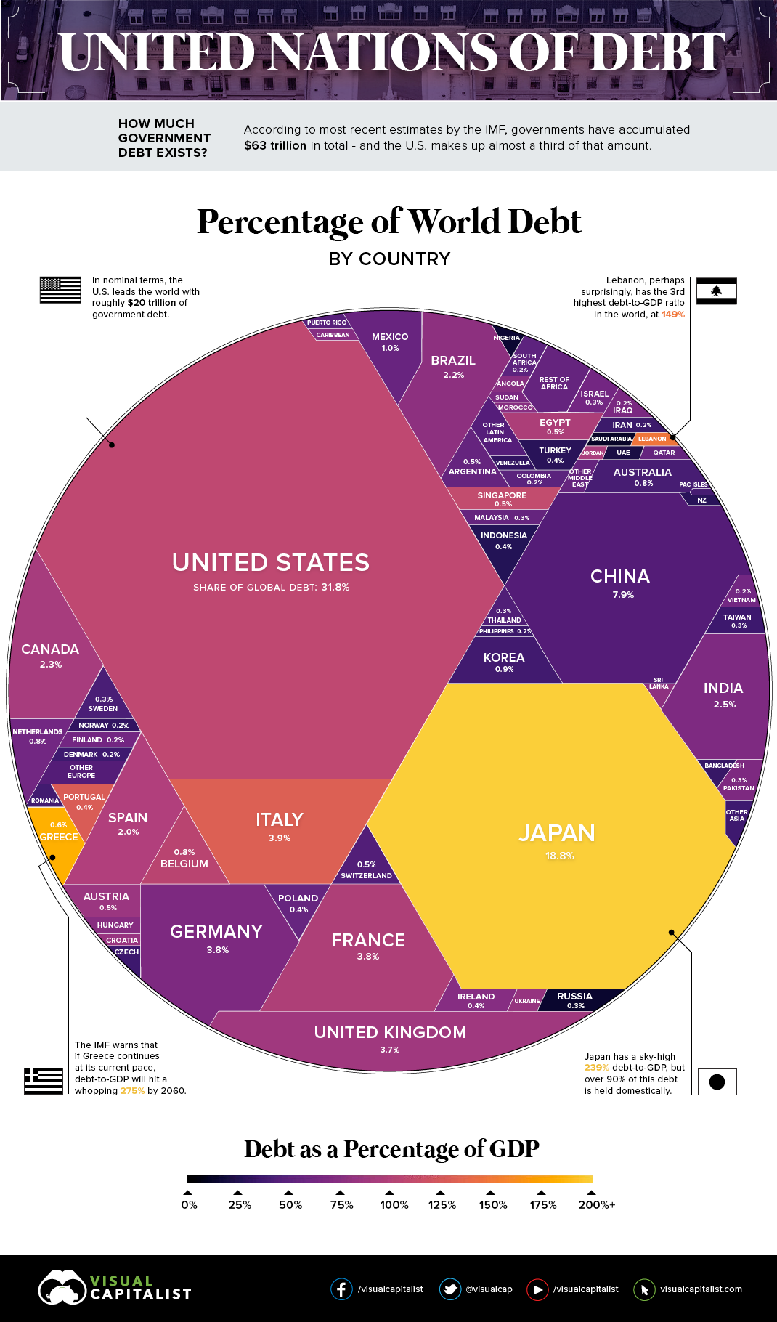

Slide 19
Jobs
Jobs versus work
Job is what is done to earn money
Work is done to accomplish something
We have always had work, but jobs only became commonplace post industrial revolution
Can we turn “work” into “jobs”
This is Doug Tjaden’s vision

Slide 20
Jobs
Issue is not technological change, but rate of change
Automation
Robotics
Artificial intelligence

Slide 21
McKinsey Global Institute
JOBS LOST, JOBS GAINED, WORKFORCE TRANSISTIONS IN A TIME OF AUTOMATION
Globally up to 30% of all jobs could be replaced by automation by 2030
“There are few precedents in which societies have successfully retrained such large numbers of people,”
Almost 50% of those thrown out of work will have to find totally new occupations
Most of those thrown out of work will be middle aged or older making retraining more difficult
Wages will suffer

Slide 22
Some quotes from the Fed
“The data indicate that despite the drop in unemployment, there has not been an increase in the number of quality jobs—those that pay enough to cover expenses and enable workers to save for the future.”
“The 2017 Scorecard reports that one in four jobs in the U.S. is in a low-wage occupation, which means that at the median salary, these jobs pay below the poverty threshold for a family of four.”
Two of the states … named (Alabama and Arkansas) had lower unemployment rates than the national average, yet one of three jobs in those states were in the “low-wage” category.

Slide 23
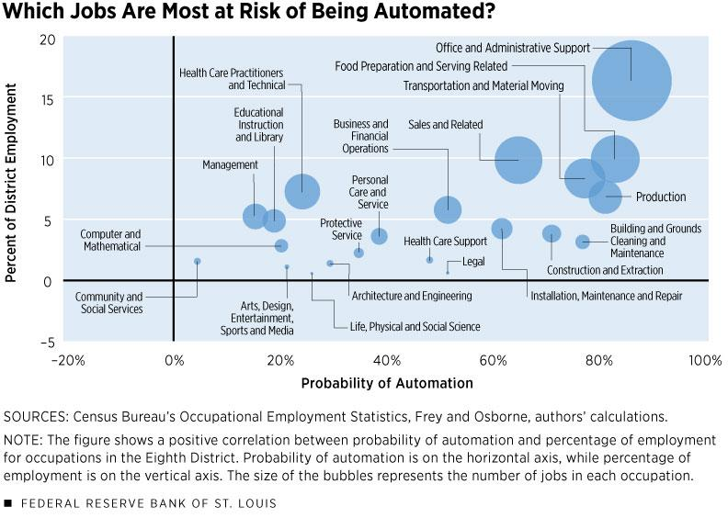

Slide 24
What is the Kingdom response?

Slide 25
Demographics

Slide 26
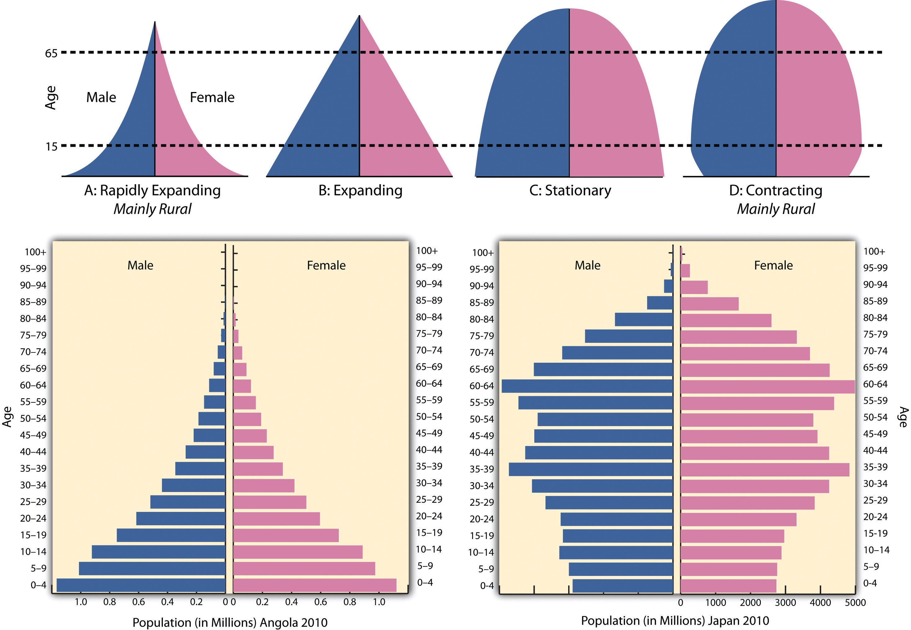

Slide 27
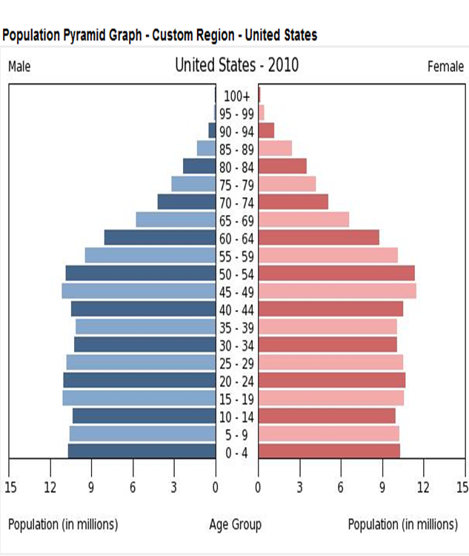

Slide 28
Data: Social Security Administration; Chart: Kortsch

Slide 29
Data: Social Security Administration; Chart: Kortsch

Slide 30
What is the Kingdom response?

Slide 31
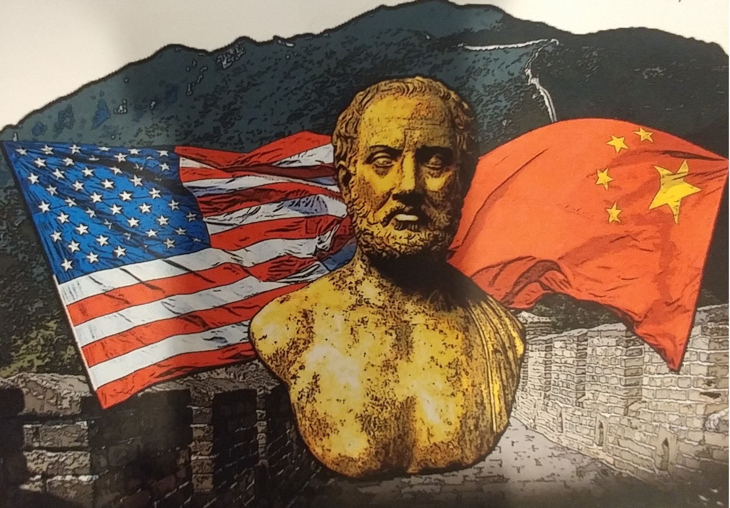
Thucydides’ Trap

Slide 32
Thucydides = author of the definitive account: The History of the Peloponnesian War
The term “Thucydides’ Trap” comes from a recent book by Graham Allison
The “Trap” is the situation under which a current hegemon feels threatened by a potential future hegemon. Why this is a trap is below.
Actions from both sides are always economic and often militaristic
Graham Allison, Destined for War: Can America and China Escape Thucydides’ Trap?

Slide 33
The Trap
1. Asymmetric information (deception and intrigue) – how one side perceives the other but not necessarily based on truth. Actions become based on fear, national interests, and seeking honor.
2. Of the 16 historical examples Allison gives in his book, 12 ended in war!
3. Economics today
- “Western way” versus “Asian way”
- WB vs. AIIB*
- IMF vs. AIIB
- both country’s leaders promise to make their countries “great again”
- build up of debt, infrastructure, and military
AIIB = Asian Infrastructure Investment Bank

Slide 34
What is the Kingdom response?

Slide 35
“It was the best of times, it was the worst of times … it was the season of Light, it was the season of Darkness ...”
Charles Dickens, A Tale of Two Cities
Every challenge is an opportunity.
For those who are poor in spirit

Slide 36
“but those who know their God will display strength and take action.”
Daniel 11:32

Slide 37
An Introduction
mid 2018

Slide 38
Monetary Institute Mission
To drive monetary and fiscal strategies that better serve and protect humanity.
We seek to effect fundamental structural changes to national monetary systems worldwide that end the nearly universal practice of debt-based money creation by private banks as the primary source of money creation.

Slide 39
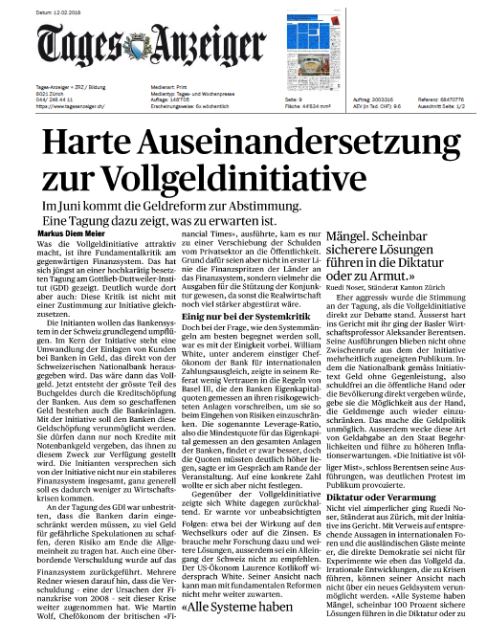
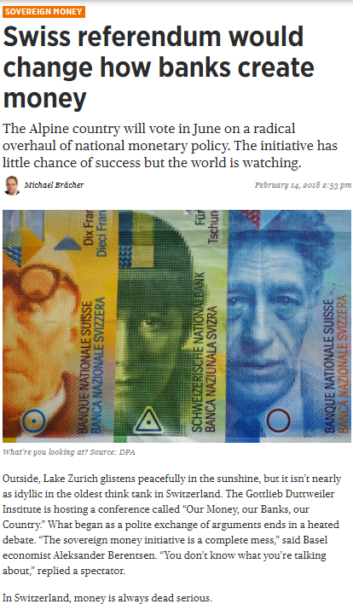
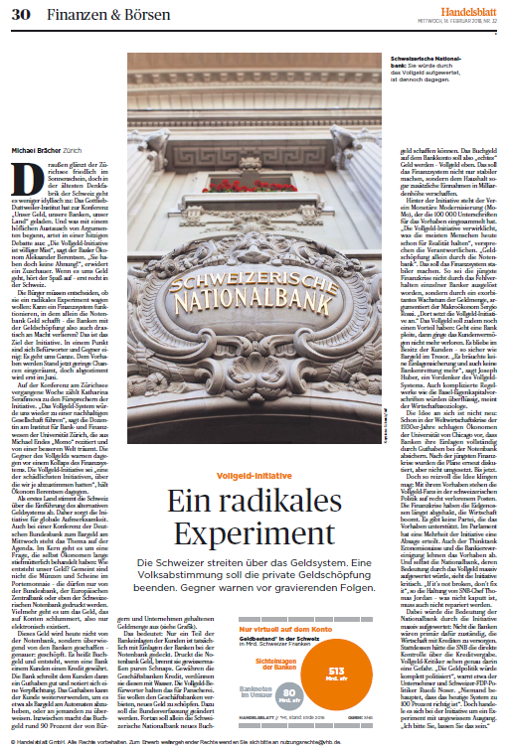
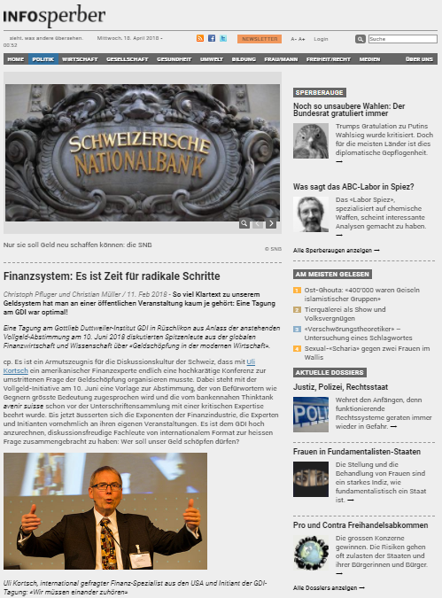
What the Institute Will Do
Primary Modes of Engagement
Media Engagement
demonstrated interest in the topic
strong need to educate a wide range of stakeholders
powerful tool for growing the Institute community
some of the Swiss media coverage of the Monetary Institute Conference in Zurich

Slide 40
What is your birthright?
Your call to action?

