Slide 1
Global Partnership Exchange Kingdom Worldview on Current International & Global Affairs Marc Nuttle Presentation Statesmen Project Meeting September 7, 2018

Slide 2
The Four Ages of History
Military
Religion
Political
Economic

Slide 3
Historical Context of Dominion Technology and Capital

Slide 4
World Economic & Political Outlook 2018

Slide 5
Complex Macro Systems

Slide 6
STATEMENT OVERVIEW
Pressures on the world economic system:
Capitalism & communism are in conflict and irreconcilable.
Chinese Federal Reserve does not manage the yuan money supply pursuant to Western accounting standards.
World governments are in too much debt.
Deficit spending has become structural.
Interest rates are now a threat to economic growth.

Slide 7
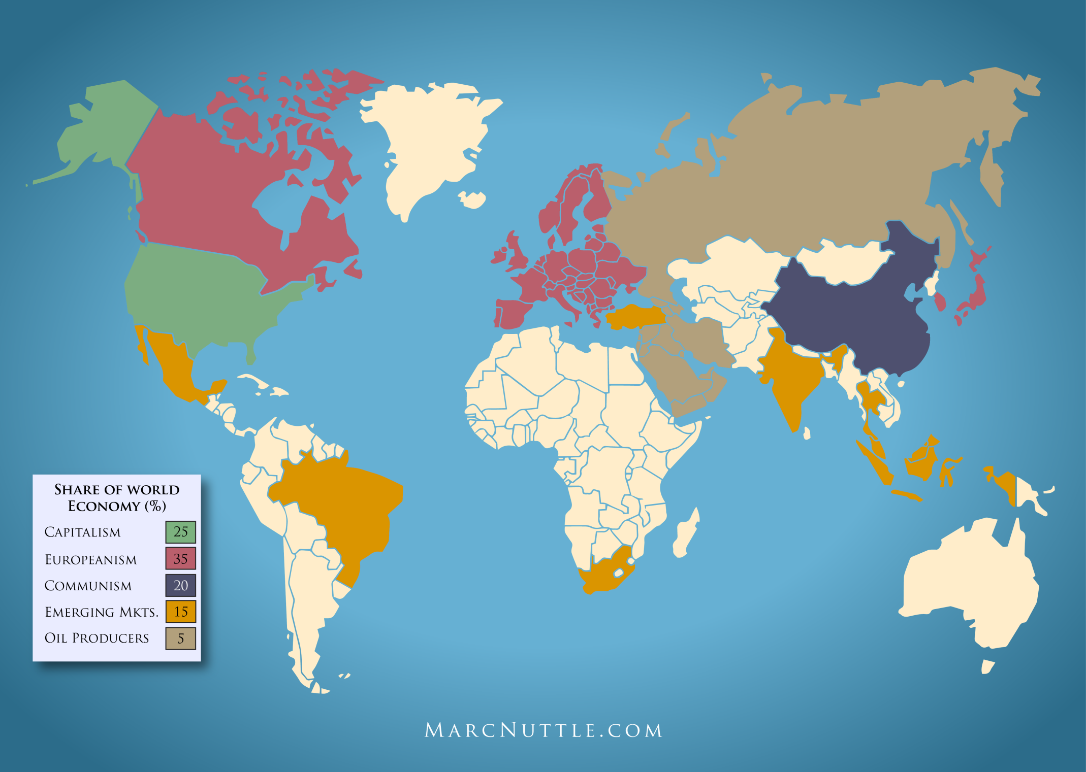
The World’s Economic Systems

Slide 8
The World
Total Assets $370-$570 Trillion
Total Liquidity $165 Trillion (all stocks,
bonds & commodities)
Total World GDP $74 Trillion

Slide 9
The World
Total Capacity for World Debt in 2018
at 70% of GDP: $52 Trillion
Sovereign Debt: 2013 2018
U.S. $18 T $19.5 T
Europe $14 T $18.0 T
Rest of World $38 T $46.5 T
Totals $70 T $84 T
Percent of World GDP 116% 120%

Slide 10
Measure of Debt/GDP
Preferred ratio is 70-80% of GDP
Greece -- 120% Debt/GDP
UK -- 125% Debt/GDP
USA -- 111% Debt/GDP
(U.S. 2015 GDP -- $17 Trillion)

Slide 11
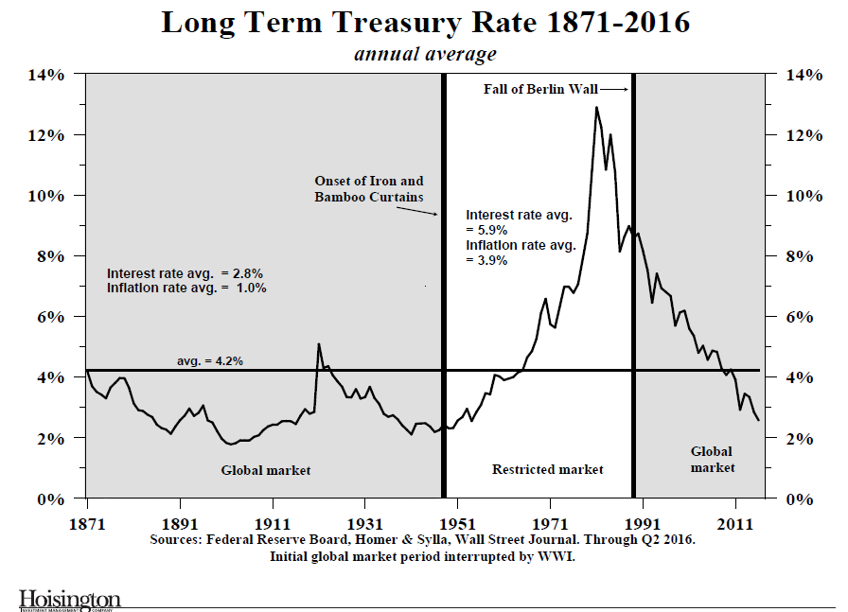

Slide 13
The Great Unraveling
©Copyright 2018 Eli Enterprises, Inc. All Rights Reserved.

Slide 14
All states are in a political identity crisis.
Parties will realign around cultural issues.
All states are in financial difficulties if not crises.
The political debate of 2018 is yet to be framed.
©Copyright 2018 Eli Enterprises, Inc. All Rights Reserved.

Slide 15
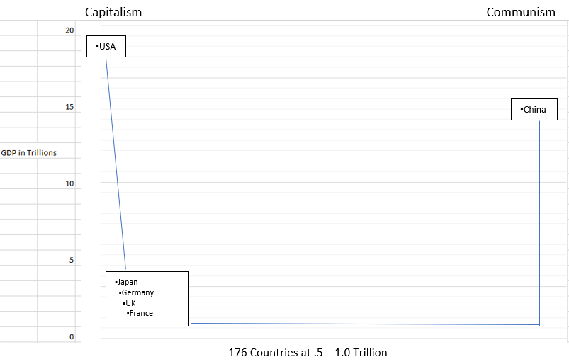
World GDP World Trade Organization Nations

Slide 16
The $247 Trillion Global Debt Bomb
The untold story of the world economy – so far at least- is the potentially explosive interaction between the spreading trade war and the overhang of global debt, estimated at a staggering $247 trillion.
Robert J. Samuelson
Washington Post
July 15, 2018

Slide 17
The $247 Trillion Global Debt Bomb
Here’s where the trade war and debt may intersect disastrously. Since 2003, global debt has soared. As a share of the world economy (gross domestic product), the increase went from 248 percent of GDP to 318 percent. In the first quarter of 2018 alone, global debt rose by a huge $8 trillion. The figures include all major countries and most types of debt: consumer, business and government.
Robert J. Samuelson
Washington Post
July 15, 2018

Slide 18
The $247 Trillion Global Debt Bomb
This may represent a final chapter to the financial crisis. The low interest rates adopted by central banks were justified as necessary to avoid a worldwide depression. Critics worried that cheap credit would rationalize risky lending that couldn’t survive higher rates. We may soon discover who’s right.
Robert J. Samuelson
Washington Post
July 15, 2018

Slide 19
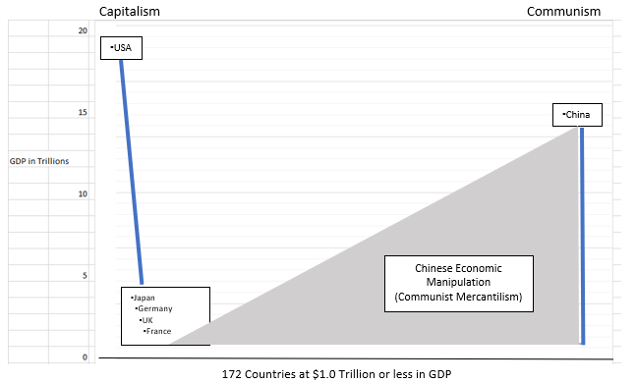
World GDP World Trade Organization Nations

Slide 20
New Horizon Council Principles & Foundational Beliefs
Truth Honor
That which we believe is critical for our Your commitment to defend and communicate
culture to prosper and for the next that truth to your fellow citizens.
generation to inherit from us.

Slide 21
Constitutional Freedom
Individuals have rights superior to all levels of government - citizens are not subjects and birth is not destiny.
States have reserved rights over the federal government.
The purpose of the Constitution is to provide and maintain rule of law, due process, independent courts, free & independent press, and transparency.

Slide 22
Economic Sensibility
Government debt should never exceed 100% of GDP - optimum debt would be 70% of GDP.
No more than 10% of the population should depend on the government for direct primary support.
90% of the population should pay some minimal amount of tax or contribute to the general revenue, even if their income is from welfare support.

Slide 23
Government By The People
The city is the primary unit of political authority. States are made up of cities, the nation, as a federation, is made up of states.
Localism, including churches, are critical in meeting society’s needs.
The government’s purpose is to implement policy which meets society’s priorities based upon proven principles.

Slide 24
Honest Foreign Relations
Rule of law
Due process
Independent courts
Free & independent press
Transparency
These five axioms are what the United States should be promoting to help foster government’s prosperity and build a positive relationship with our foreign partners. Therefore, the purpose of foreign policy is to establish these five principles worldwide.

Slide 25
Citizen Responsibility
Citizens have an obligation to contribute as much to society as they take, to the best of their ability. They should hold each other accountable for their determinations based upon principles that bind us. And they should take the time to determine for themselves what eternal truths they believe and want to pass on to the next generation as their inheritance of values.

Slide 26
World Trade Organization Status

Slide 27
Brexit Will Impact Key World Trade Elements particularly commodities

Slide 28
Change is Inevitable The Great Unraveling Will Continue

Slide 29
The Answer is a World Trade Partnership of Principled Nations

Slide 30
Global Partnership Exchange
A new world trade platform is being initiated and established for a world trading system to efficiently manage sovereign country assets and private sector products for cooperative product development, targeting of markets for distribution, and utilizing technology to eliminate corruption for the security of transactions.

Slide 31
Presented by Marc Nuttle
Statesmen Project Meeting
September 7, 2018
MarcNuttle.com
©Copyright 2018 Eli Enterprises, Inc.
All Rights Reserved

