Slide 1
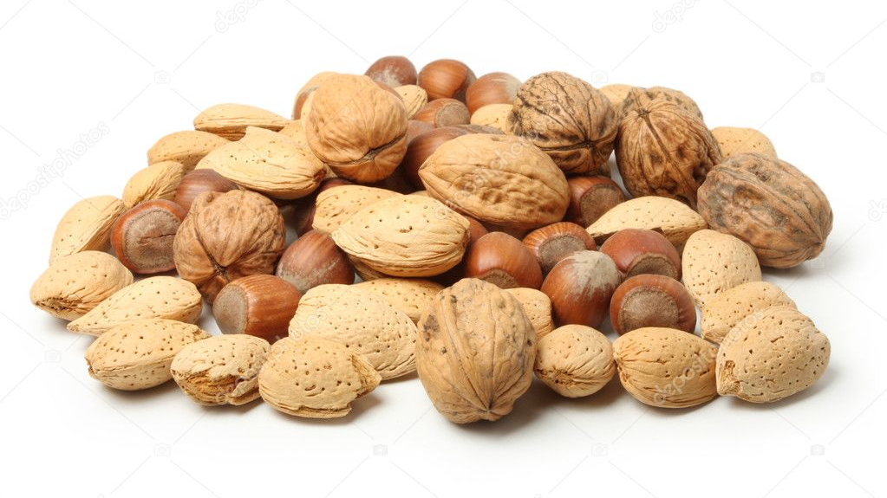
Worldview in a Nutshell
Katherine Gallagher for GoStrategic

Slide 2
Worldview:
the assumptions (or presuppositions) that we make that determine our view of reality.

Slide 4
The 3 Root Presuppositions
The Nature of God
The Nature of Man
The Nature of Truth

Slide 5
The Worldview Journey
We begin our journey as those who are influenced (the lens of fallen human nature). Most people never move beyond being influenced.

Slide 6
The War for Worldview
Worldview is fought on three levels:
The presuppositional (heart) personal
The evidential (mind) institutional
The applicational level (actions) cultural

Slide 7
The Worldview Process

